Slide 1
Note: results could change with alternative mathematical formulation
Currently using LP
Will need to move to MILP to capture ancillary services (up/down balancing reserves)

Slide 2
LMPs for Year = 2000
4 topologies tested (# of nodes = 75, 100, 125, 150)
20 largest hydroelectric dams

Slide 3
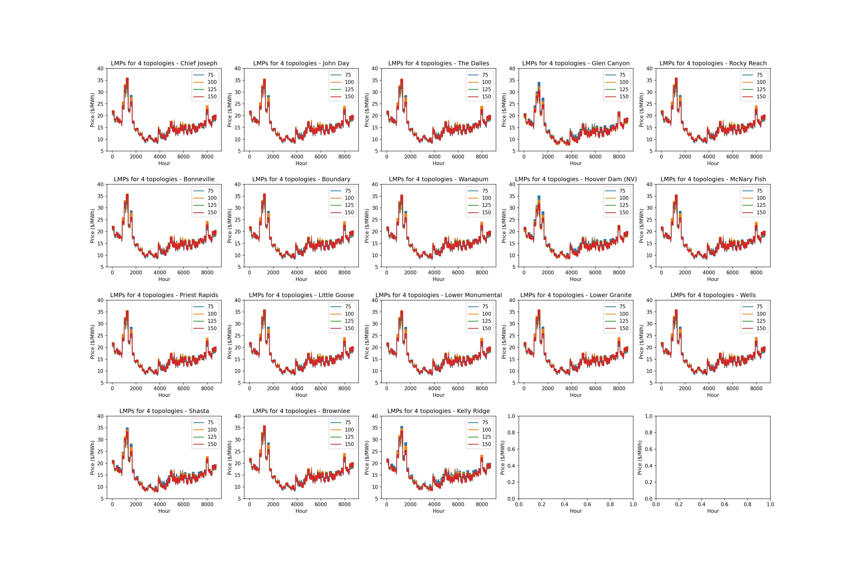

Slide 4
Difference in LMPs (perfect minus persistence)
Year = 2000
4 topologies tested (# of nodes = 75, 100, 125, 150)
20 largest hydroelectric dams

Slide 5
